Slide 1

CI-CD Practices with the TANGO-controls framework in the context of the Square Kilometre Array (SKA) Telescope Project
Matteo Di Carlo (INAF-OAAB)
Yilmaz U., Harding P., Bartolini M., Le Roux G., Dolci M.

Slide 2
SKA Project
International effort to build two radio interferometers in South Africa and Australia
One Observatory monitored and controlled from the global headquarters (GHQ) based in the United Kingdom at Jodrell Bank
Software development process is Agile
Mainly incremental and iterative
Many teams (17) including a specialized team (known as system team) devoted to support the continuous Integration, test automation and continuous Deployment.

Slide 3
Why CI-CD?
When many parts of the project are developed independently for a long period of time (weeks or longer),
Code base and build environments diverges
When changes are integrated
Weeks in verifying that everything works
Developers spend time in solving bugs introduced months earlier

Slide 4
Continuous integration
Set of development practices that requires developers to integrate code into a shared repository several times a day.
Each check-in is then verified by an automated build, allowing teams to detect problems early.

Slide 5
The practices
Single source repository (for each component of the system)
minimize the use of branching
Automate the build (build all in one command)
Automate testing (together with the build)
Every commit should build on an integration machine
Commit often! (at least once per day)
the smaller is the change the easier is the fix
Build fast (so that a problem in integration can be found quickly)
Multi-stage deployment: every build software must be tested in different environments
Ref: martinfowler.com/articles/continuousIntegration.html

Slide 6
Delivery vs Deployment
Continuous delivery
Automate the delivery of new releases of software
Deployment has to be predictable and sustainable
The code must be in a deployable state
Testing needs to cover enough of your codebase.
Continuous deployment
One step further: every single commit to the software that passes all the stages of the build and test pipeline is deployed into the production environment

Slide 7
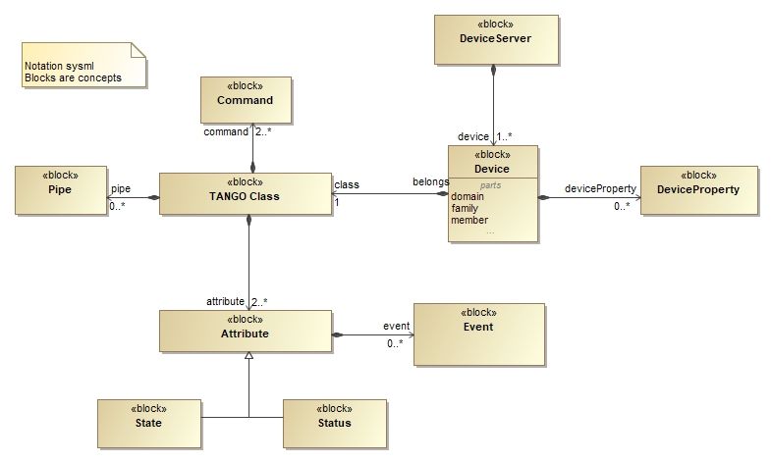
TANGO-controls framework
Ref: www.tango-controls.org

Slide 8
Containerization
SKA == set of elements == a set software modules
For each module there is one repository
For each repository there is one docker image
convenient way to package up applications and preconfigured server environments

Slide 9
SKA-Docker - Containerized environment for TANGO-controls application
Debian buster
MariaDB
TANGO dependencies
TANGO test
TANGO ArchiverDB
TANGO database
TANGO C++
TANGO Java
TANGO Panic
TANGO itango
TANGO VNC
extend
TANGO Dsconfig
TANGO python
TANGO DatabaseDS
TANGO Archiver
TANGO Rest
Docker image
TANGO Panic GUI
SKA Module 0
SKA Module 1
…
SKA Module n
Notes:
Decision 0

Slide 10
Kubernetes and Helm
Kubernetes (k8s) for container orchestration (kubernetes.io)
Service == TANGO Device Server
Helm for packaging SKA k8s applications (helm.sh)
Tool for managing Kubernetes charts
Chart is a package of pre-configured Kubernetes resources (set of information for running a Kubernetes application)
For each SKA element there must be an helm chart for running it in k8s!
Use of Makefiles for lifecycle management (one command for build images, start application using helm, test application and clean)!
Notes:
Decision 1 and 2

Slide 11
Integration with Helm
Helm has the concept of dependency
An helm chart can have one or more sub-charts
The integration of SKA elements can be done with this concept
Element A
KEY
Element B
Element C
Depends-on
Helm Chart
Element D
Element E
Element F
Element G
Notes:
How do we do integration?

Slide 12
Helm sub-charts Architecture
Operational aspects of using dependencies: the sub-charts are
aggregated into a single set; then
sorted by type followed by name; and then
created/updated in that order.
For every SKA element, there is at least an umbrella chart for integration testing
G
B
G
F
B
F
A
UMBRELLA
E
A
UMBRELLA
UMBRELLA
B
D
C
D

Slide 13

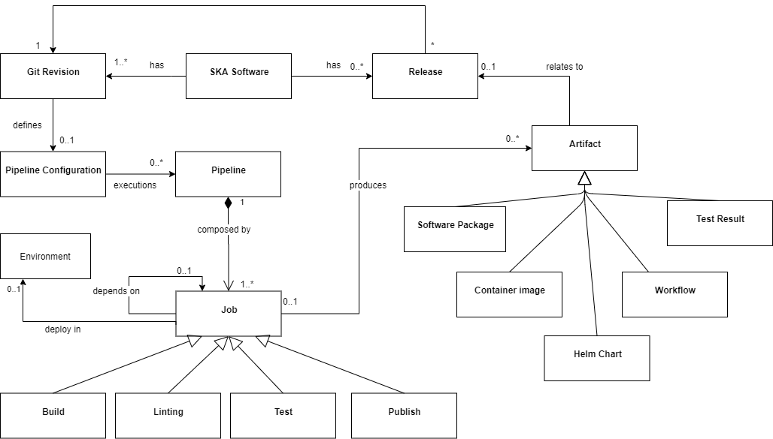
GitLab
Web-based DevOps lifecycle tool that provides a Git-repository manager providing wiki, issue-tracking and continuous integration and deployment pipeline features
Environments allow control of the continuous deployment done in k8s

Slide 14
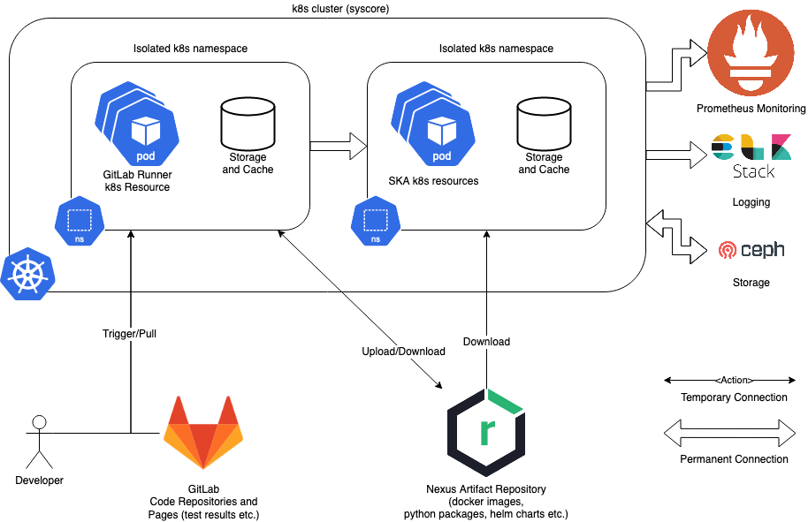
Gitlab pipeline – run-time

Slide 15
Deployment and Testing
For each repo and for each commit (!):
install the (umbrella) chart in an isolated namespace
wait for every container to be running
For the tests:
Create a k8s pod (a container) in the isolated namespace
Run pytest inside the above pod
Return the tests results
uninstall the (umbrella) chart

Slide 16
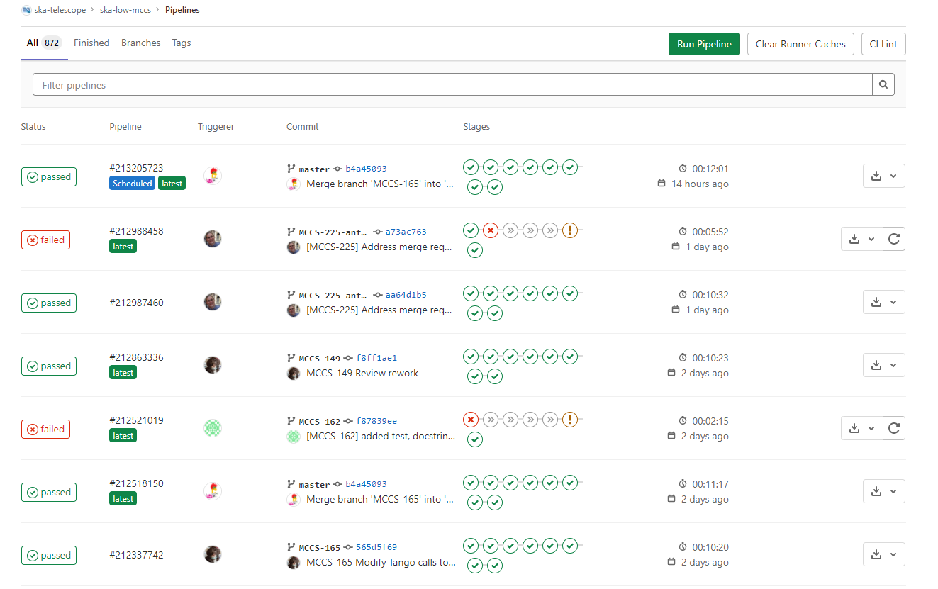
Example pipeline

Slide 17
Every component has its own repository with story based branching (2 weeks lifecycle)
Conclusion
Single source repository (for each component of the system)
minimize the use of branching
Automate the build (build all in one command)
Automate testing (together with the build)
Every commit should build on an integration machine
Build fast (so that a problem in integration can be found quickly)
Multi-stage deployment: every build software must be tested in different environments
Large use of Makefile
Every commit trigger a GitLab pipeline that build, lint, execute unit-testing and integration testing
It depends: building the ska-docker images can take 30 minutes, while testing takes up to 10 minutes
Integration testing in Gitlab is done within an isolated k8s namespace which are completely separate each other
One namespace is kept as “blessed” environment

Slide 18
Thanks

